Slide 1
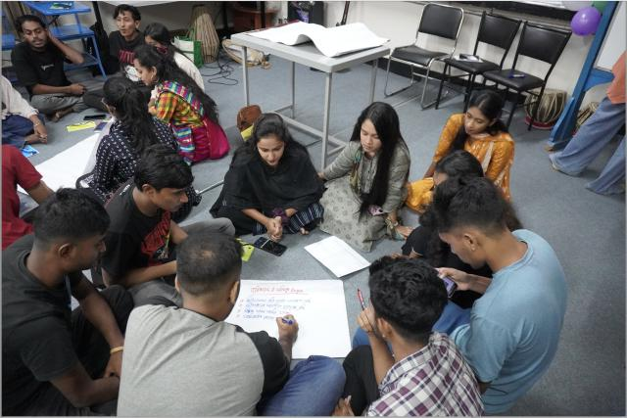
Changing the Narrative: Young Voices for Climate Justice
World Student Christian Federation Asia-Pacific

Slide 2
In Bangladesh, a Mission and Service-supported workshop empowered young leaders to tackle climate justice, turning awareness into action for their communities.
Notes:
In 2024, Mission and Service partner the World Student Christian Federation Asia-Pacific collaborated with the Bangladesh Student Christian Movement on a workshop called “Youth Leading Change: Climate Justice through Cultural Movement.” Through discussions and activities, it aimed to raise awareness among young people about climate challenges and empower them to take local actions.
Over four days, 50 passionate students from various regions of Bangladesh came together to address the critical issue of climate change. They explored the severe impacts that climate change has on communities and livelihoods in Bangladesh, particularly the displacement caused by floods. Floods force families to migrate to Dhaka, now one of the world’s most densely populated cities.
The heart-wrenching stories of displaced families deeply resonated with the participants, igniting their determination to drive change. Equipped with knowledge and tools, these young leaders are now poised to advocate for climate justice and inspire their communities.
Your generous support of Mission and Service helps make empowering work like this possible. Thank you.

