Slide 1
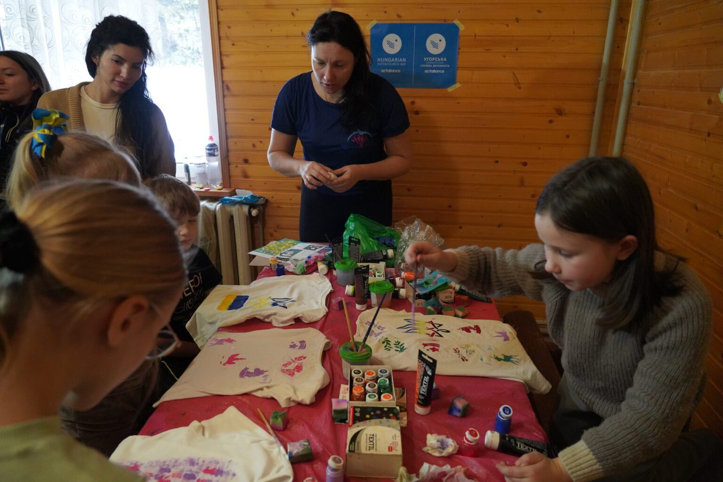
Hope for mothers, strength for families
ACT Alliance and Hungarian Interaid Church

Slide 2
ACT member Hungarian Interchurch Aid welcomes mothers and their children in the “Happy Family” initiative, providing space for healing and resilience.
Notes:
In the Eastern Carpathian Mountains, far from the chaos of war, a retreat in Tukhlya, Ukraine offers rest and renewal to mothers who have given everything for their families. Supported by Mission and Service partner ACT Alliance, ACT member Hungarian Interchurch Aid has welcomed 135 mothers and their children in the “Happy Family” initiative, providing space for healing and resilience.
In early January 2025, 18 mothers and their little ones arrived. All had either been displaced by war or lived near the frontlines. Many are exhausted, burdened by grief and overwhelming responsibilities. “I always thought only about my children—their clothes, food, education,” shares Yulia, a mother of five who lost her husband a year ago. “Here, I was able to stop and think about myself.”
With psychological support, hiking, art therapy, and group sessions, the retreat helps women regain their inner strength. While the women focus on healing, their children participate in creative activities, allowing everyone time for self-care. Many women hesitated before they left home, worried about stepping away from their duties and earnings. “How could I leave everything?” Yulia recalled. “But now I see how much I needed this time to regain my strength and return home with love and energy.”
For many, this is their first experience receiving psychological support. “These exercises helped me understand myself better,” says Nataliya, who fled to Lviv after losing her home. “I learned techniques I can use every day to cope.”
This retreat is made possible with help from your gifts to Mission and Service. While it cannot erase hardship, it offers strength for the journey ahead. Your support provides a space for healing, restoring hope, and empowering those in need. Thank you for making a difference.

