Slide 1
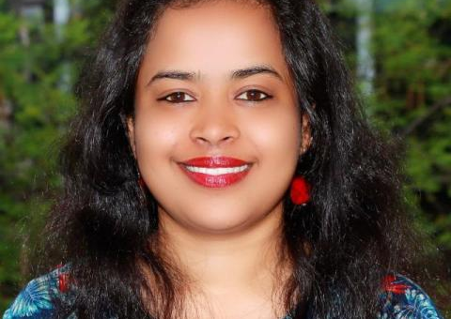
Breaking Barriers: Women in Theology and Leadership
Theological education scholarship

Slide 2
The Rev. B. Silpa Rani is actively encouraging women to pursue theological education and engage in leadership roles.
Notes:
In India, social and cultural factors limit access to theological education for women in comparison to men. The Rev. B. Silpa Rani is actively encouraging women to pursue theological education and engage in leadership roles.
When Silpa started her first degree in Theology, she spent two years as the only woman in a class of 16. Now, years later, as she works on her doctoral dissertation, she has seen a gradual increase in the enrolment of women in theological programs. While this is encouraging, Silpa recognizes that there is still a long journey forward. While she seeks to empower modern women, she is also working to shed light on the experiences of women and minorities of the past.
Silpa was the recipient of a theological education scholarship, which paved her way to join the faculty at Bishop's College, Kolkata. She has been exploring the unique identity of the Qumran community within the context of the Dead Sea Scrolls. She is actively researching to identify the women, children, and minority groups of the society, drawing parallels between the Qumran context and contemporary Indian context.
Your Mission and Service gifts provide support to leaders like Silpa, who are actively working to empower women and change the world.

